Slide 1
Serial and Parallel Port interfacing
SSI protocol

Slide 2
Synchronous Serial Interface (SSI)
Synchronous communication
Device can operate as a master or a slave
Channel can have one master or one slave or multiple slaves
The master initiates all data communication

Slide 3
Difference between UART and SSI
UART is asynchronous, each device has its own clock but have same frequency
In UART clock signal is not included in the interface signal
In SSI both devices communicate with synchronous serial
Clock signal is included in communication
Clock is generated by master

Slide 4
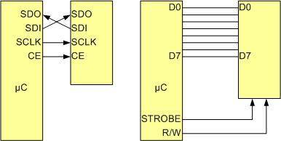
SPI Bus vs. Traditional Parallel Bus Connection to Microcontroller

Slide 5
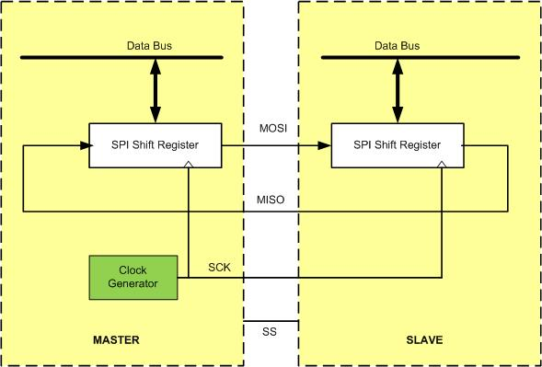
SPI Architecture

Slide 6
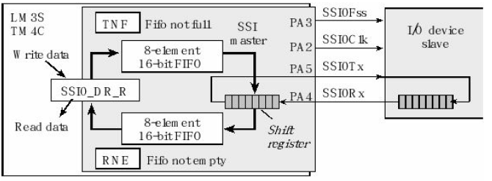
SPI architecture of TM4C

Slide 7
GPIO Pin Assignment for all 4 SSI Modules
SSI Module Pin | GPIO Pin | SSI Module Pin | GPIO Pin
SSI0Clk | PA2 | SSI2Clk | PB4
SSI0Fss | PA3 | SSI2Fss | PB5
SSI0Rx | PA4 | SSI2Rx | PB6
SSI0Tx | PA5 | SSI2TX | PB7
SSI1Clk | PD0 or PF2 | SSI3Clk | PD0
SSI1Fss | PD1 or PF3 | SSI3Fss | PD1
SSI1Rx | PD2 or PF0 | SSI3Rx | PD2
SSI1TX | PD3 or PF1 | SSI3TX | PD3

Slide 8
SSI Module Base Address
SSI Module | Base Address
SSI0 | 0x40008000
SSI1 | 0x40009000
SSI2 | 0x4000A000
SSI3 | 0x4000B000

Slide 9
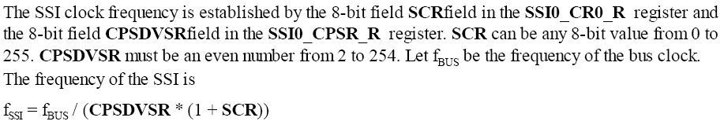
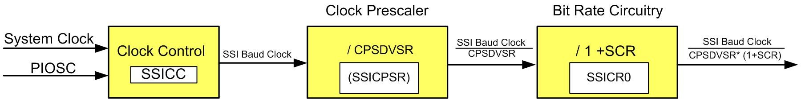
SSI clock frequency

Slide 10
Example
If prescaler is 32, system clock = 16MHz, what is SCR if Bit rate is 100K
Asnwer: SCR= 16M/(32x100K) – 1 = 4

Slide 11
SPI Clock Polarity and phase
Clock Polarity (CPOL) | Clock Phase (CPHA) | Data read and change time | SPI Mode
0 | 0 | read on falling edge, changed on a rising edge | 0
0 | 1 | read on rising edge, changed on a falling edge | 1
1 | 0 | read on rising edge, changed on a falling edge | 2
1 | 1 | read on falling edge, changed on a rising edge | 3

Slide 12
Steps to configure SSI Module
Enable Clock to SPI as well as the port being used
Do all the configurations for PORT (alternate function etc)
Set the control registers of SSI: CR1, CR0, CPSR, SR

Slide 13

Enable clock of SSI RCGCSSI

Slide 14
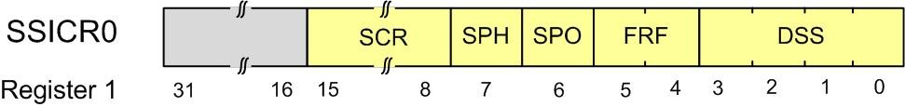
Control Register 0 (SSICR0)
Bits | Name | Function | Description
0-3 | DSS | SSI Data Size Select | 0x03 to 0x0F for 4-bit to 16-bit data size 0x07 means 8-bit data size
4-5 | FRF | SSI Frame Format Select | 0 for SPI, 1 for TI, and 2 for MICROWIRE frame format
6 | SPO | SSI Serial Clock Polarity | Clock polarity
7 | SPH | SSI Serial Clock Phase | Clock phase
8-15 | SCR | SSI Serial Clock Rate | BR=SysClk/(CPSDVSR * (1 + SCR))

Slide 15

Setting Bit Rate
Set CPSDVSR and SCR bits in the SSICR0 register

Slide 16
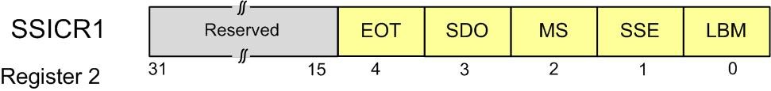
SSI Control Register 1 (SSICR1)
MS= 0 when master else slave
SSE = enable/disable bit

Slide 17

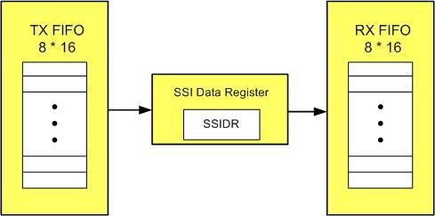
Data register (SSIDR)

Slide 18

Status Flag Register (SSISR)
Bits | Name | Function | Description
0 | TFE | SSI Transmit FIFO Empty | The bit is 1 when the transmit FIFO is empty
1 | TNF | SSI Transmit FIFO Not Full | The bit is 1 when the SSI transmit FIFO not full
2 | RNE | SSI Receive FIFO Not Empty | The bit is 1 when the receive FIFO is not empty
3 | RFF | SSI Receive FIFO Full | The bit is 1 when the receive FIFO is full
4 | BSY | SSI Busy Bit | The bit is 1 when the SSI is currently transmitting or receiving
Wait on busy flag for reading/writing for single byte transfer at a time

Slide 19
Example Code
Master Controller
TM4C
Slave Controller
TM4C
Laptop (Teraterm)
Tx
Clk
Fss
Rx
Clk
Fss
UART0

Slide 20
void init_SSI2(void)
{
SYSCTL_RCGCSSI_R |= 4; /* enable clock to SSI2 */
SYSCTL_RCGCGPIO_R |= 2; /* enable clock to GPIOB for SSI2 */
while((SYSCTL_PRGPIO_R&0x0002) == 0){};// ready?
/* configure PORTB 4,5,7*/
GPIO_PORTB_AMSEL_R &= ~0xB0; /* disable analog for these pins */
GPIO_PORTB_DEN_R |= 0xB0; /* and make them digital */
GPIO_PORTB_DIR_R |= 0xB0; /* and make them digital */
GPIO_PORTB_AFSEL_R |= 0xB0; /* enable alternate function */
GPIO_PORTB_PCTL_R |= 0x20220000;/* assign pins to SSI2 */
GPIO_PORTB_DATA_R |= 0x20 ; /* keep SS idle high */
/* SPI Master, SPO = 0, SPH = 0, clock = 16 MHz, 8 bit data */
SSI2_CR1_R = 0; /* disable SSI and make it master */
SSI2_CR0_R = 0x00003307;; /* 9600 SSI clock, SPI mode, 8 bit data, SCR= */
SSI2_CC_R = 0; /* use system clock */
SSI2_CPSR_R = 0x20; /* prescaler divided by 0x20 */
SSI2_CR1_R |= 2; /* enable SSI2 */
}
Initialization of SSI2 (master)
Alternate function of a pin can be checked from the pdf document placed on xeon: Pins Alternate functions .pdf

Slide 21
Transmitting data by master
void SSI2Write(unsigned char data)
{
GPIO_PORTB_DATA_R &= ~0x20; /* assert SS low */
SSI2_DR_R = data; /* transmit high byte */
while(SSI2_SR_R & 0x10); /* wait until transmit complete */
GPIO_PORTB_DATA_R |= 0x20; /* keep SS idle high */
}

Slide 22
void init_SSI2(void)
{
SYSCTL_RCGCSSI_R |= 4; /* enable clock to SSI2 */
SYSCTL_RCGCGPIO_R |= 2; /* enable clock to GPIOB for SSI2 */
while((SYSCTL_PRGPIO_R&0x0002) == 0){};// ready?
/* configure PORTB 4,5,6*/
GPIO_PORTB_AMSEL_R &= ~0x70; /* disable analog for these pins */
GPIO_PORTB_DEN_R |= 0x70; /* and make them digital */
GPIO_PORTB_DIR_R |= 0x00; /* and make them digital */
GPIO_PORTB_AFSEL_R |= 0x70; /* enable alternate function */
GPIO_PORTB_PCTL_R |= 0x02220000;/* assign pins to SSI2 */
/* SPI Master, SPO = 0, SPH = 0, clock = 16 MHz, 8 bit data */
SSI2_CR1_R = 0x04; /* disable SSI and make it slave */
SSI2_CR0_R = 0x00003307; /* 9600 SSI clock, SPI mode, 8 bit data, SCR=0x33 */
SSI2_CC_R = 0; /* use system clock */
SSI2_CPSR_R = 0x20; /* prescaler divided by 0x20 */
SSI2_CR1_R |= 2; /* enable SSI1 */
}
Initialization of SSI2 (Slave)
Alternate function of a pin can be checked from the pdf document placed on xeon: Pins Alternate functions .pdf

Slide 23
Receiving data by slave
char SSI2Read()
{
char data;
while(SSI2_SR_R & 0x10);
data = SSI2_DR_R ;
return data;
}

Slide 24
Other examples
GLCD on boosterpack is interfaced using SSI
DAC chip uses SSI

